Slide 1

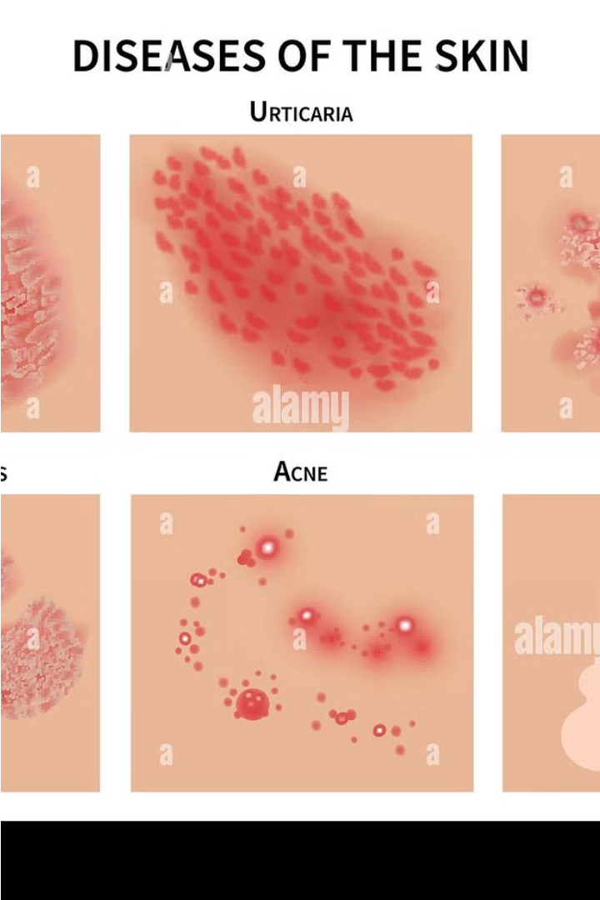

Skin Disease Classification with Deep Learning
Deep learning has revolutionized the field of medical imaging, enabling the automated classification of various skin conditions. This presentation provides an in-depth look at the key steps involved in this groundbreaking approach.
Aa
by Abraham Obianke

Slide 2
Overview of Deep Learning in Medical Imaging
Accuracy
Scalability
Interpretability
Deep learning models have demonstrated remarkable accuracy in identifying skin diseases, often outperforming human experts.
The ability to process large volumes of data makes deep learning a scalable solution for real-world medical applications.
Advancements in explainable AI are improving the interpretability of deep learning models, enhancing trust and transparency.

Slide 3
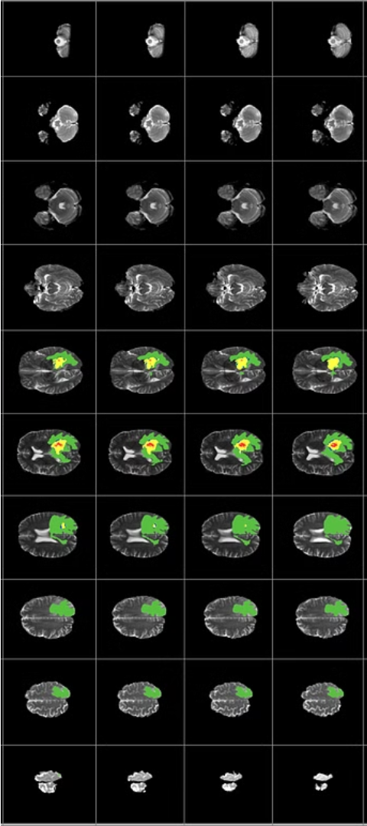
Dataset Preparation and Preprocessing
1
Data Collection
2
Image Augmentation
Gathering a diverse and representative dataset of skin condition images is crucial for model performance.
Applying techniques like rotation, scaling, and flipping can significantly increase the size and diversity of the training data.
3
Preprocessing
Standardizing image size, color channels, and normalization help ensure consistent input for the deep learning model.

Slide 4
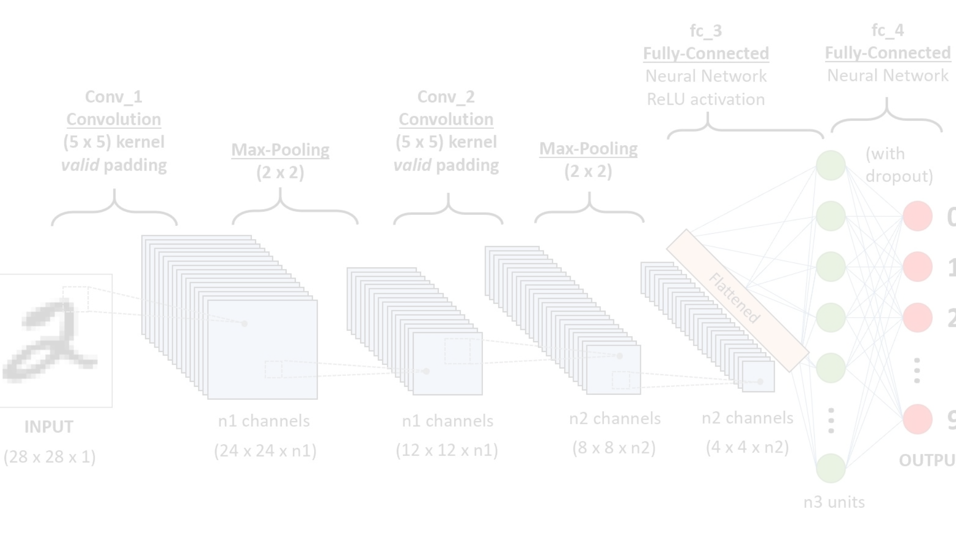
Convolutional Neural Network Architecture
Convolution Layers
1
Extracting local features from the input images through a series of convolution and pooling operations.
2
Dense Layers
Combining the extracted features to classify the input into specific skin disease categories.
Optimization
3
Tuning hyperparameters and model architecture to achieve the best performance on the validation set.

Slide 5

Training and Validation Strategies
Train-Validation-Test Split
Early Stopping
Data Augmentation
Monitoring validation performance to prevent overfitting and identify the optimal training epoch.
Leveraging techniques like rotation, scaling, and flipping to enhance the diversity of the training data.
Carefully dividing the dataset into training, validation, and test sets to ensure unbiased model evaluation.

Slide 6




Performance Evaluation Metrics
Accuracy
Precision
Recall
F1-Score
The proportion of correct predictions made by the model.
The ratio of true positive predictions to total positive predictions.
The ratio of true positive predictions to the total number of actual positive instances.
The harmonic mean of precision and recall, providing a balanced performance metric.

Slide 7
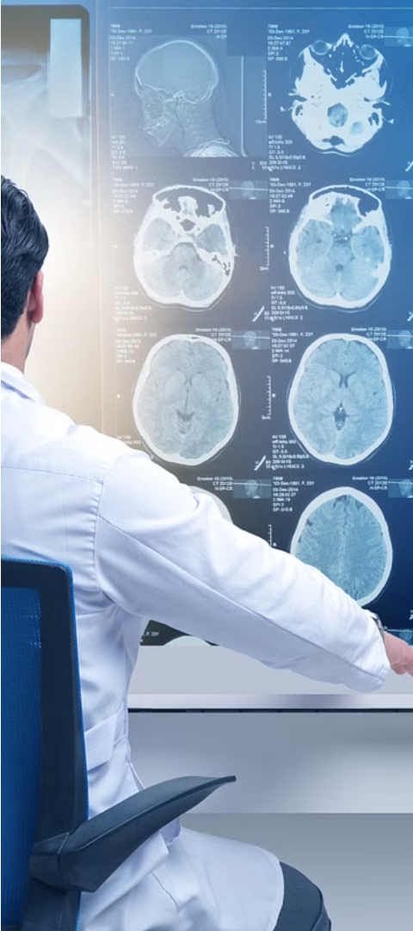



Challenges and Limitations
Data Scarcity
Obtaining a large, diverse dataset of skin condition images can be challenging, particularly for rare diseases.
Interpretability
Improving the interpretability of deep learning models to understand the reasoning behind their predictions.
Real-World Deployment
Ensuring the seamless integration of deep learning-based skin disease classification into clinical workflows.

Slide 8
Conclusion and Future Directions
Improved Accuracy
Advancements in deep learning architectures and training techniques will continue to enhance the accuracy of skin disease classification.
Personalized Medicine
Integrating patient-specific data and factors will enable more personalized and precise disease diagnosis and treatment.
Collaborative Effort
Multidisciplinary collaboration between clinicians, computer scientists, and researchers will be crucial for driving progress in this field.

